Slide 1

*Sexual Reproduction*
Evolution’s Decisive Downfall
God’s Decisive Design
By
Ron Payne
Note: This Presentation Is Suitable For All Audiences

Slide 2

Do Horses Fly?

Slide 3
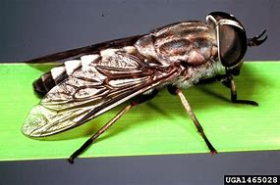
Some Horses Do Fly!!!

Slide 4
“Horses Fly”
IS THIS STATEMENT TRUE?
Absolutely
Likely
Possibly
Probably
Improbably
Impossible
Apply
Critical Thinking
Logic
To
Science
Reality
Bias
Need-Want
Hope
Agenda

Slide 5
Types of Reproduction
Reproduction in living systems are complicated and some organisms exhibit multiple types and variations of the main types.
Asexual – cloning usually single cell organisms.
“Parasexual” – crossover and gene exchanges in bacteria for example
Vegetative, budding, spores in certain plants
Sexual – male and female co-mingling of genetic material
This presentation will focus on sexual reproduction since:
Exhibited in most multi-cellular organisms
Expresses genetic diversity and variation to the largest extent
Has most direct & clear effect on the validity of evolutionary theory

Slide 6
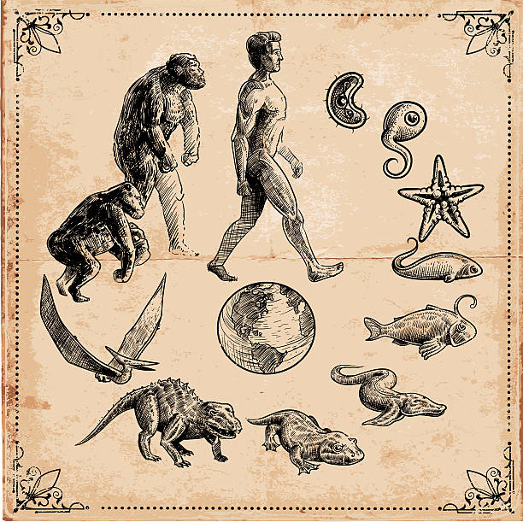
SEXUAL REPRODUCTION
HOW DOES IT FIT INTO THE EVOLUTIONARY PICTURE?

Slide 7


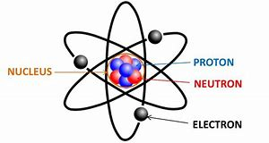
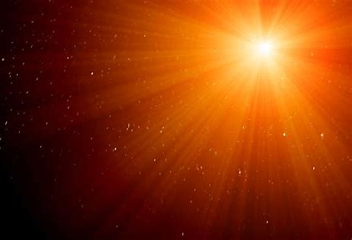



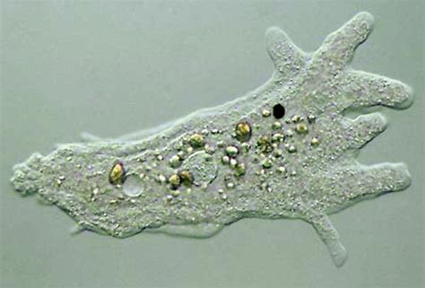
EVOLUTION: Nothing to 1st Life
Time
Atoms
Energy
Time
Atoms
Chance Chemical Interaction
Energy
1st LIFE

Slide 8
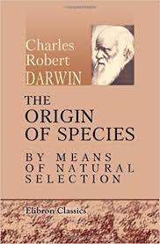
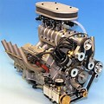
EVOLUTION: Microbes to Man
Chance Mutational Gene Changes
Time
Energy
1st LIFE
New Species
Sexual Reproductive Engine to Pass on Gene Changes
Natural Selection Process to Preserve Positive Gene Changes Generation to Generation

Slide 9
SEXUAL REPRODUCTION
WHY SO CRUTIAL FOR EVOLUTION?

Slide 10
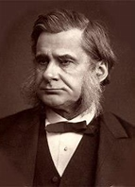
“The great tragedy of Science: the slaying of a beautiful hypothesis by an ugly fact”
Thomas Huxley
(Darwin’s Bulldog)

Slide 11
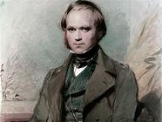
“If it could be demonstrated that any complex organ (or process like sexual reproduction) existed, which could not have possibly been formed by numerous, successive, slight modifications, my theory would absolutely break down.”
Charles Darwin
Sexual Reproduction has been called the
“Queen of Evolutionary Problems”
Why?
What is the “ugly fact”

Slide 12


The sexual reproductive engine or process for passing on genetic information from one generation to the next and any associated genetic changes leading new species has to be
FULLY FUNCTIONAL DURING THE FIRST GENERATIONAL CHANGE otherwise
THERE WILL BE NO 2nd, 3rd, 4th , … GENERATIONS
NO NEW SPECIES
NO EVOLUTION
THE END (No Beginning)
A “Beautiful Hypothesis – Slayed”
Sexual Reproduction is a “One Generational Issue”

Slide 13
Definition of Generational
For this presentation it means the organisms “life span”.
Some reproduce only once, others reproduce multiple times and when reproductive maturity is reached varies widely.

Slide 14
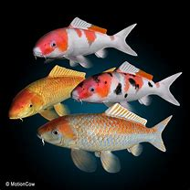
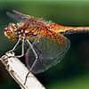
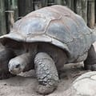
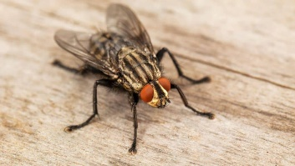
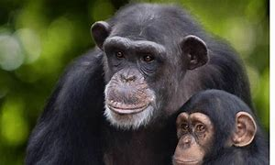
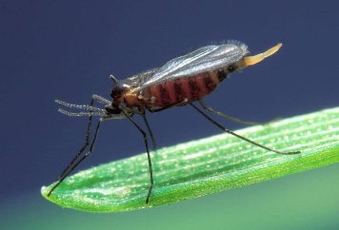
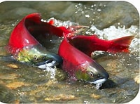
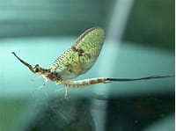
Animal Life Spans
Koi fish 225 Yrs
Dragon Fly 4 months
Tortoise 150 Yrs
House Fly 4 weeks
Chimps 50 Yrs
Midge
5 days
Salmon 2-7 Yrs
Mayfly
5 minutes

Slide 15
EVOLUTION: Microbes to Man, as a theory, like Darwin stated “absolutely breaks down”!
No matter how old the earth is, a fully functional reproductive engine must be operating from the start during the first generation:
For the mayfly: evolution has 5 minutes to get it right
For the koi: evolution has 225 years to get it right
SEXUAL REPRODUCTION IS A ONE GENERATIONAL ISSUE
No
New Species
Chance Mutational Gene Changes
Sexual Reproductive Engine to Pass on Gene Changes
Time
Natural Selection Process to Preserve Positive Gene Changes Generation to Generation
Long Ages No Longer A FACTOR

Slide 16
EVOLUTION Says:
If you have enough time, even the most “irreducibly complex” organism or process could possibly have “formed by numerous, successive, slight modifications”.
Sexual Reproduction Says:
“If you are a Mayfly, you have 5 minutes to get it right!”
Time
“Long Ages” No Longer A FACTOR

Slide 17

Theme of the Presentation
The Take-Away
As Huxley said:
“… the slaying of a beautiful hypothesis (evolution) by an ugly fact”
The ugly fact is:
Sexual Reproduction
The “One Generational Issue”

Slide 18
Types of Reproduction: Asexual and Sexual

Slide 19
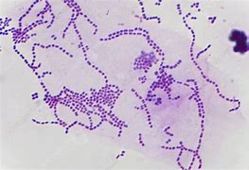
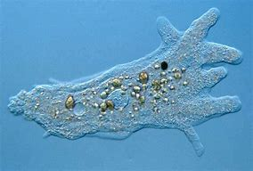
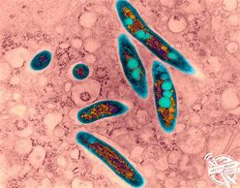
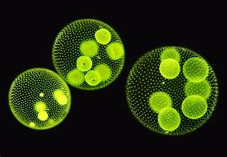
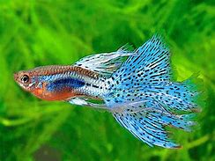
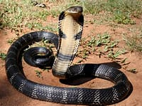
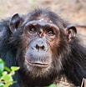
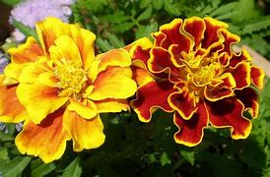
ASEXUAL reproduction is typical with single cell life forms.
SEXUAL reproduction is typical with the vast majority of multicellular animal species and significant types of plant species (like flowering seed producers).
There are a number of other reproductive processes, especially in the plant world.
There are a number of “para-sexual” gene exchange and few “unique” mechanisms with some species.

Slide 20
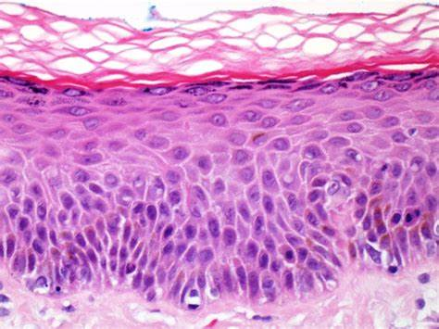
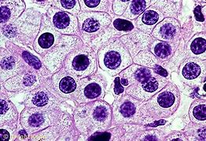
What is Asexual Reproduction?
Duplicating the genetic material (chromosomes) of a parent cell of a particular plant or animal and then the cell divides into two identical new fully functional daughter cells identical to the parent (cloning) via a process called Mitosis.
Note: Growing new cells or replacing old cells except for sex cells is done by Mitosis.
Example: New skin cells

Slide 21
What is Sexual Reproduction?
Genetic material (chromosomes) from male and female reproductive cells of a parent organism are reduced by ½ via a process called Meiosis.
During fertilization, male and female reproductive cells each containing ½ the original number of chromosomes co-mingle to form a new immature daughter cell containing genetic traits of both parent cells.
After gestation period, the immature daughter cell matures to a new fully functional organism exhibiting a combination of genetic traits of both original parents for that particular organism with a specific male or female distinction .

Slide 22
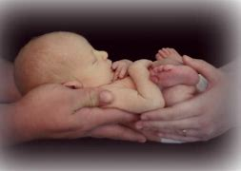
Example of Human Sexual Reproduction
Human cell = 46 chromosomes
Male Sperm cell = 23 chromosomes
Female Egg cell = 23 chromosomes
Embryo = 46 chromosomes
Meiosis
Fertilization
Gestation
And Birth

Slide 23
Origin of Sexual Reproduction?
Generally, evolution teaches that life first reproduced asexually and then sexual reproduction process evolved from the asexual reproduction.
In this presentation, we will assume asexual reproduction evolved (similar major “ugly fact” issues) but we shall focus on origins of sexual reproduction.
Mitosis Meiosis
(Asexual) (Sexual)

Slide 24
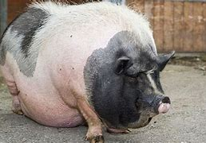
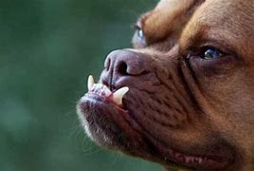
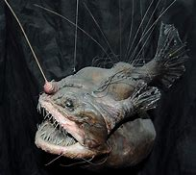
Let’s Look At Some “Ugly” Facts
Apply Some Critical Thinking and Logic
About
Sexual Reproduction being a
“One Generational Problem of Evolution”

Slide 25
Regarding the Evolution of Sexual Reproduction
(and for that matter - anything)
Justifying the validity of the Evolution IS NOT based on:
-Why or it’s benefits
- The fact that exists
Justifying the validity of the Evolution IS based on:
-How it came about
Critical Thinking
A Note to Remember

Slide 26

For any trait to be expressed, to actually happen, there must have evolved a set of DNA coding for that trait.
Where did the DNA code for sexual reproduction come from when we assume there was only asexual genes available?
How did natural selection select for sexual reproduction when sexual reproduction is first required for natural selection to operate? (Circular Reasoning!!!)
Sexual Reproduction DNA Code
No Code – No Sexual Reproduction - No Evolution

Slide 27
Asexual to Sexual
Mitosis to Meiosis

Slide 28
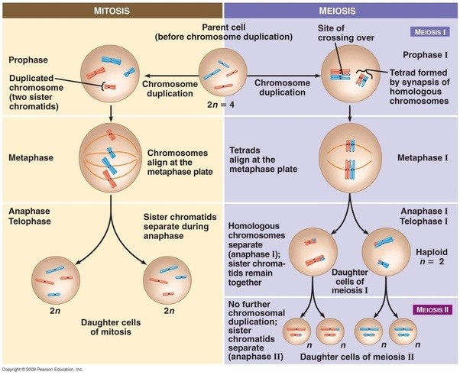
Meiosis
ASEXUAL
SEXUAL
Parent Cell
Gene Transfer & Crossover
Sex Cells
(Clones)

Slide 29
Critical Questions
Asexual Mitosis to Sexual Meiosis
Genetic instructions for sexual meiosis would interfere with the mitosis process terminating reproduction.
Half asexual, half sexual? Meantime, no asexual or sexual reproduction would result.
Sexual meiosis would have to concurrently develop in both the male and female organism at the same time. Timing is everything.
Without sexual meiosis, how would you get male and female?
Can asexual mitosis account for the “new” reproductive organs and biochemicals required in sexually reproductive organisms since they are not present in asexual organisms.
Correct reproductive DNA code, enzymes, hormones and biochemicals?
Sex cells exactly 50% of parent cell. Why not 45%?
Complete transition from Asexual to Sexual in the first generation?
If not, then no second generation – DEAD END

Slide 30
Male and Female
Who’s First?
A female but no male
A male but no female
Male & Female simultaneously in the first generation?
If not, then no second generation – DEAD END

Slide 31
Male and Female Physical Design
I’m Not All Here?
“Houston, we have a problem!”
½ male?
½ female?
How does fertilization happen?
How does gestation happen?
How does birth, egg hatching, seed formation or germination happen?
100% male and female simultaneously in the first generation?
If not, then no second generation – DEAD END

Slide 32

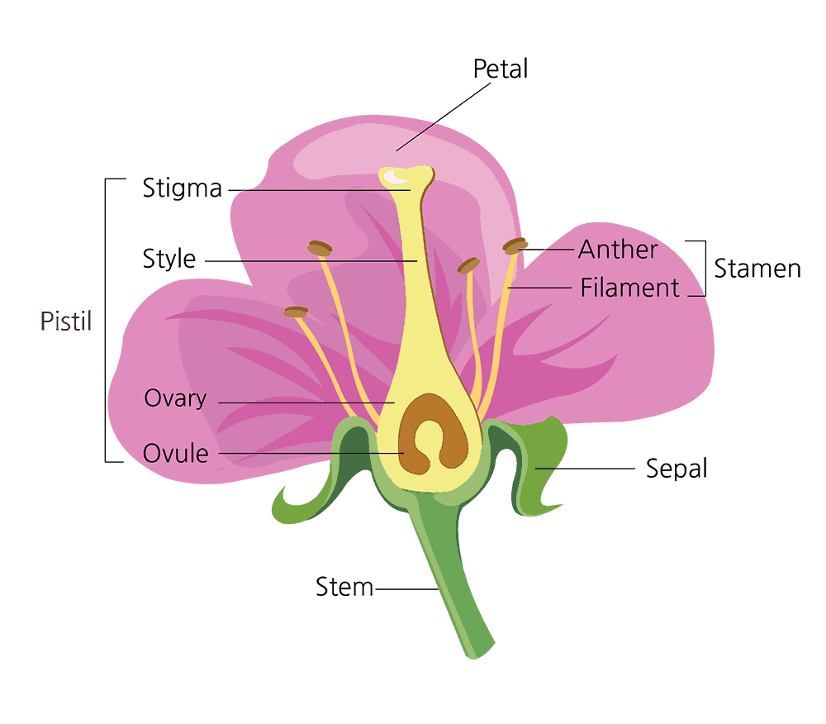
Male and Female Example
Male (Pollen)
Female
(Ovum)
Male and Female Meiosis
Pollen lands on stigma
Pollen tube develops
Pollen travels to Ovule
Pollen fertilizes Ovum
Seed(s) form

Slide 33
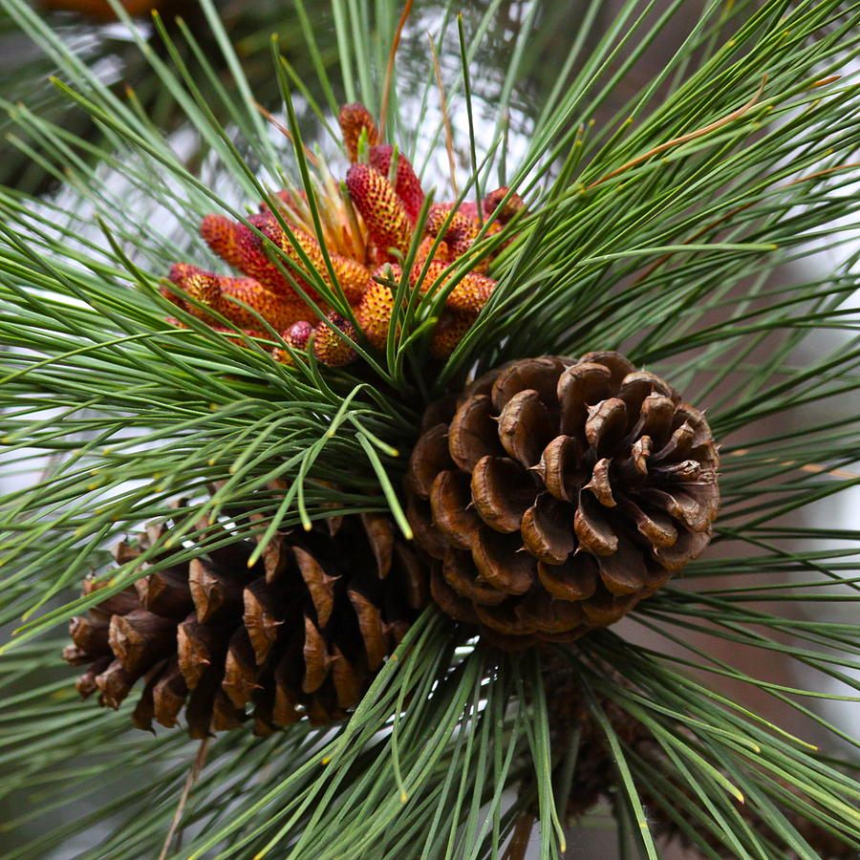
Male and Female Physical Design
1000’s Organisms Each with Unique Morphology (Form)
Male and Female Forms Compatibly Matched
Male (Pollen)
Female
Matched compatible male and female morphology simultaneously in the first generation?
If not, then no second generation – DEAD END

Slide 34
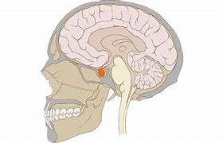
Specialized Organs Facilitating Reproduction
Pituitary Gland
-Found in all vertebrates
- Releases hormones controlling sperm formation and timing of egg meiosis and release
- Located in the brain
- Size of a small marble

Slide 35
Specialized Organs Facilitating Reproduction
Prostrate Gland
- Male mammals have prostrate glands
- Located in the male at the base of the bladder
- Size of a walnut in humans
- Releases fluid protecting sperm entering the female reproductive tract

Slide 36
Specialized Organs Facilitating Reproduction
Ovary
- Produces, stores and releases eggs for fertilization.
- Immature eggs are reproduced by mitosis (cloning) and then undergo meiosis prior to release
- Controls number of eggs released for fertilization ( 1 or 1000s at a time)
- Releases hormones related to reproduction

Slide 37
Critical Questions
Specialized Organs Facilitating Reproduction
Pituitary Glands, prostrate glands, ovaries and numerous other organs and structures all critical to successful reproduction. Some, like the pituitary gland, also support other non-reproductive body functions. The 1000s of different organisms have varied organs and structures matched to their unique reproductive system.
How did all required organs form at the same time?
How did the “multipurpose” pituitary gland form just the right reproductive hormones?
How could 1000s of different reproductive organs and structures form compatibly matched with 1000s of different organisms.
What mechanism drove the DNA coding for the various organs?
How could a placenta (organ that nourishes the developing fetus) develop slowly from a non-placental “common ancestor”?
Required organs forming simultaneously in the first generation?
If not, then no second generation – DEAD END

Slide 38
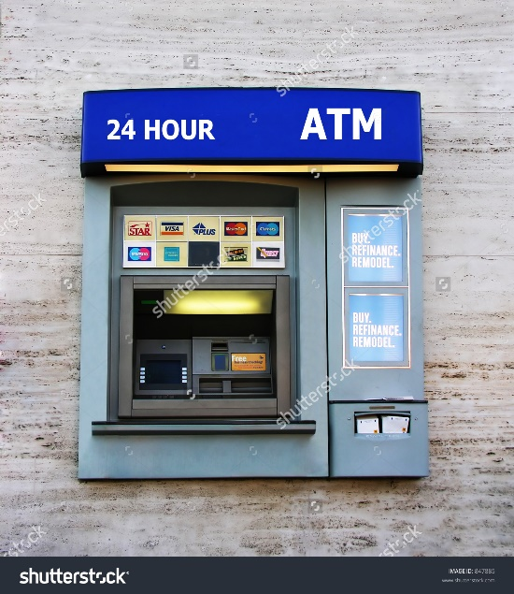
Species to Species Reproductive Road Blocks
Fertilization Pin Numbers

Slide 39
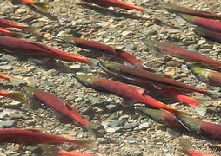
Critical Questions
Fertilization Pin Numbers
Eggs and sperm of the same species have species specific chemical codes and corresponding receptor preventing cross-fertilization from other species.
Handy safety feature for spawning fish!
How did same species codes and receptors gradually form?
A perfect matching code formed concurrently in the male and female?
Transitioning species would require simultaneous pin number changes.
The DNA for one pin code set cannot pass on a new set – self limiting
The pin number system prevents “spawning” new life forms on purpose.
Unique matching “Pin” numbers in the first generation?
If not, then no second generation – DEAD END

Slide 40
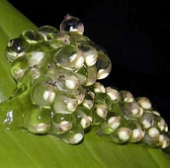
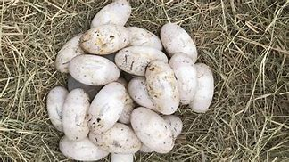
Transition Points on the Evolutionary Tree
Amphibians to Reptiles

Slide 41
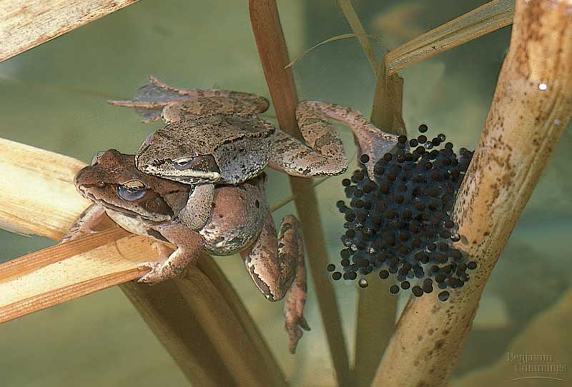
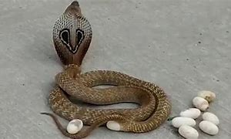
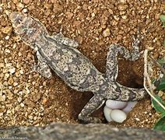
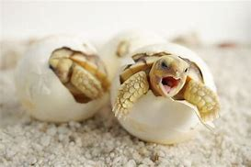
Amphibians Reproduce by External Fertilization
Reptiles Reproduce by Internal Fertilization
(Amniotic Egg)

Slide 42
Critical Questions
Amphibians to Reptiles
How could the first reptilian amniotic egg develop from a amphibian non-amniotic egg through small successive mutational changes?
How many successive permutations would it take to develop the physical structures to facilitate internal fertilization in reptiles compared to simple egg and sperm discharge in amphibians.
How could fully functional male and female reptiles develop simultaneously?
How could the reptile egg shell develop from a soft amphibian soft moist egg membrane?
The reptilian system in the first generation?
If not, then no second generation – DEAD END

Slide 43

Male and Female Reproductive Ritual
Reproductive instincts and drives required in both male and females at the same time.
1000’s Organisms Each with Unique Mating “Dances”
Tied to Meiotic Maturity of Sperm and Egg
Male didn’t show – out chasing herring
100% male and female matched mating drives in the first generation?
If not, then no second generation – DEAD END

Slide 44
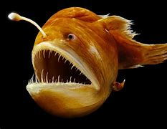
Male and Female Bizarre Reproductive Ritual
Deep Sea Angler Fish
Male attaches (bites) permanently to the female
Male circulatory system co-mingles as a parasite
Permanent source of sperm
Attached Male
How did this system evolve in the first generation?
If not, then no second generation – DEAD END

Slide 45
Evolutionary Answers
How did sexual reproduction evolve?
(List of theories on next slide)

Slide 46

Sexual Reproduction has been called the
“Queen of Evolutionary Problems”

Slide 47

Leading Atheist Richard Dawkins View
“The other assumption I have glossed over, that of the existence of sexual reproduction and crossing over (Meiosis), is more difficult to justify … This is an extremely difficult question for evolutionists to answer … I am frankly going to evade it …”
-The Selfish Gene -
“For reasons that I haven’t the space to go into, the existence of sexual reproduction poses a big theoretical puzzle for Darwinians”
- The Blind Watchmaker -

Slide 48

Leading Canadian Evolutionist Professor Graham Bell
“Sex is the queen of problems in evolutionary biology. Perhaps no other natural phenomenon has aroused so much interest; certainly none has showed so much confusion. The insights of Darwin and Mendel, which have illuminated so many mysteries have so far failed to shed more than a dim and wavering light on the central mystery of sexuality …”
-The Masterpiece of Nature: The Evolution of Genetics and Sexuality-

Slide 49
What Conclusion Can We Make?
Sexual Reproduction Is Like a Flying Horse:
Evolution’s Decisive Downfall
Sexual Reproduction
Is
Not Evolution’s Holy Grail
But It’s
Wholly Fail

Slide 50
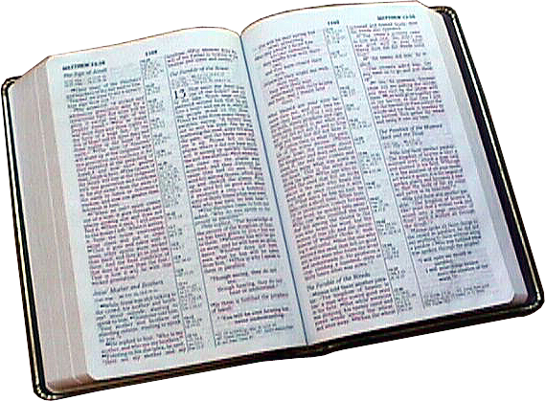
Logical Deduction
Your Christian Faith
It is rational and reasonable to believe that God, not unknown events, created sexual reproduction fully functional to facilitate the first generation of all life.

Slide 51
Sexual Reproduction
God’s Decisive Plan
All Along
Where did Mr. and Mrs. Sockeye Salmon come from and develop the ability to sexually reproduce from the get go?
What Does the Bible Tell Us?

Slide 52
Sexual Reproduction:
God God’s First Command
So God created man in His own image, in the image of God He created him: male and female He created them.
And God blessed them, and God said to them, “Be fruitful and multiply, and fill the earth and subdue it … “
Genesis 1:27-28

Slide 53
God made Adam and Eve “Fit” For Each Other
Then the Lord said, It is not good that man should be alone; I will make a helper FIT for him.
Genesis 2:18
FIT for Adam: What does that mean?
A relational partner spiritually, emotionally, mentally; to understand, honor, cherish and value God and each other.
AND
The physical compatibility to reproduce: the ability to “be fruitful and multiply”

Slide 54
The Context for God Providing A “FIT” Partner for Adam
… God formed every beast of the field and every bird of the air, and brought them to man … but for man there was not found a helper fit for him.
Genesis 2:19-20
Not FIT for Adam: What does that mean?

Slide 55
Creatures Not Fit For Adam
Mrs. Chimp
Mrs. Sockeye
Not Mrs. Cobra
Certainly Not Mrs. Angler Fish
All the wrong reproductive requirements (chromosomes, organs, pin numbers, specialized organs, etc.) and obviously the relational and spiritual.
- God designed suitable “FIT” mates for all creatures according to their kinds -

Slide 56

God’s Plan

Slide 57
Takeaway from the Presentation
As Huxley said:
“… the slaying of a beautiful hypothesis (evolution) by an ugly fact”
And the “ugly facts” are:
1. Sexual Reproduction - The “One Generational Issue”
2. Evolutionary Time is Not a Factor

Slide 58
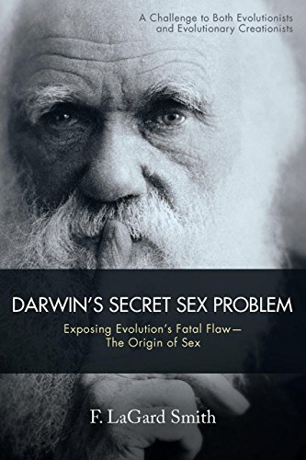
Highly Recommended
Fun
Witty
Solid Critical Thinking
Available on Amazon for under $20

Slide 59

Remember Our Task
Be prepared to make a solid defense to those who challenge our faith
2 Tim 3:15

Slide 60

Ask Critical Questions
How do you know it is true?
Has it ever been observed?
Are you making any assumptions?

Slide 61




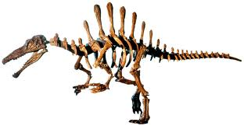
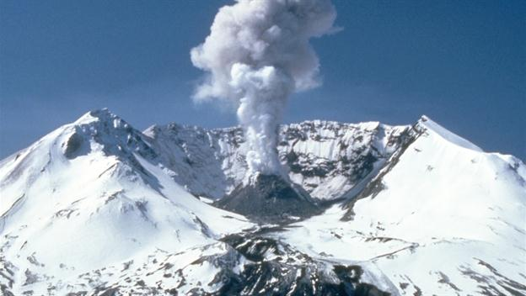
How to Prepare
Read creation science books, magazines and articles
Watch creation science DVDs
Attend creation science classes
Attend creation science conferences
Attend creation science meetings
Go on creation science field trips
Visit creation science museums

Slide 62
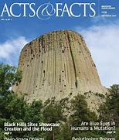

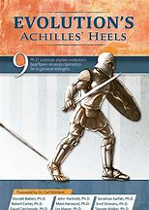

How to Start
Subscribe to Institute for Creation Research (ICR) “Acts and Facts” and visit ICR online
Visit Answers in Genesis (AIG) online
Visit NWCreation.net or the Snohomish County Apologetics Forum to learn about local monthly creation science seminars, meetings, events and links. Meetings held monthly in Arlington, Bothell, Federal Way, Portland, Yakima, Tri-Cities and others.
Start a library of good creation science books and DVDs
Visit the Mt. St. Helens Creation Center

Slide 63

Consider a Summer Family Field Trip
Mt. St. Helens
Dry Falls

Slide 64
Psalm 118:8
It is better to take refuge in the Lord than to put confidence in man.
Psalm 111:2
Great are the works of the Lord, studied by all those who have pleasure in them.

