Slide 1
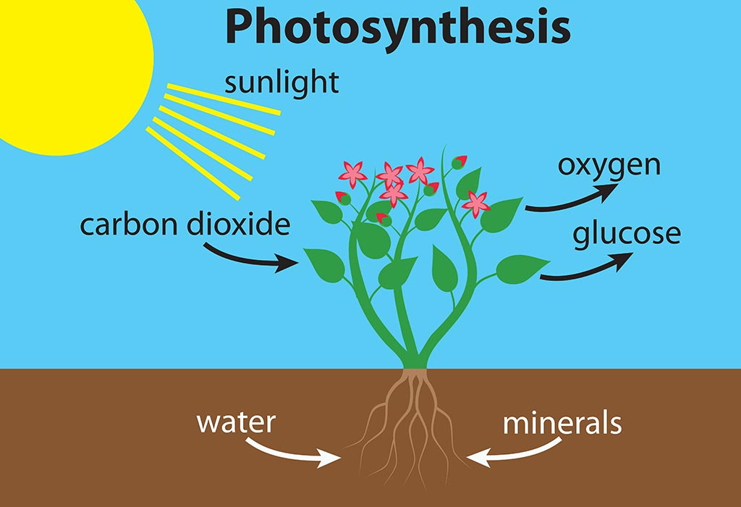
*Photosynthesis*
God’s Dynamic Dynamo
Defying Evolutionary Dogma
By
Ron Payne

Slide 2

*Photosynthesis*
Presentation Goals
1. Honor the Lord Ascribing Him Glory, Honor and Power
2. Demonstrate how much God loves and cares for us
3. Show evolutionary theory is seriously lacking credibility

Slide 3
What is Photosynthesis?
Photo = Light (Sun)
Synthesis = Make (Bio-Chemicals)

Slide 4
For Itself
Glucose
For Animals and Humans
Ammonia
Nitrate
Sulfate
Phosphate

Slide 5

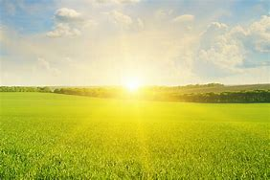
Photosynthesis is a Chemical Factory
Inside the Plant:
Chemical Energy
Sugars (Glucose)
Plant Metabolism
Manufacture of Plant Bio-Chemicals and Structure
(starch, carbohydrates, amino acids, proteins, enzymes, cellulose, DNA, RNA, Vitamins, ETC)

Slide 6
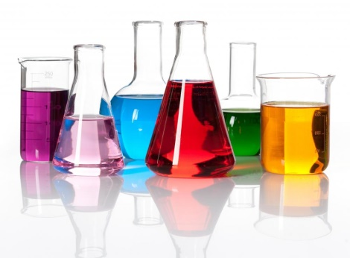
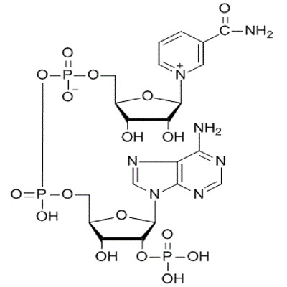
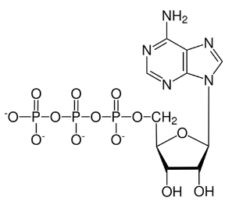
Better Living Through Chemistry

Slide 7
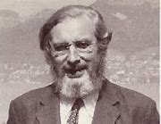
Life Rides on Chemistry
But
Is Not Chemistry
A.E Wilder-Smith (Swiss Chemist)

Slide 8
GOD
The Chief Master Chemist

Slide 9
For thus says the Lord, who created the heavens (He is God), who formed the earth and made it (He established it;
He did not create it in chaos,
He formed it to be inhabited):
I am the Lord, and there is no other.
Isa 45:18

Slide 10
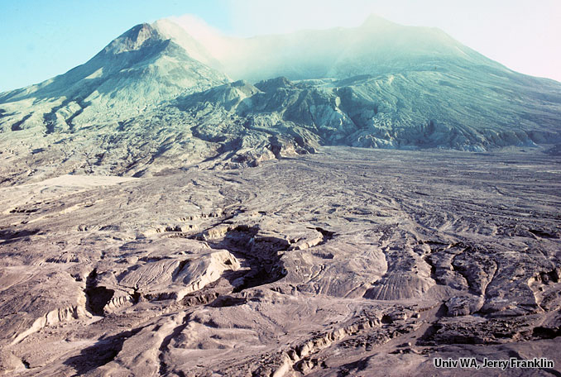
What does CHAOS mean?
Without Photosynthesis and Plants our world would look like:

Slide 11
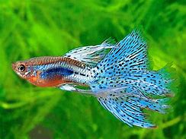
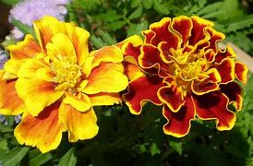
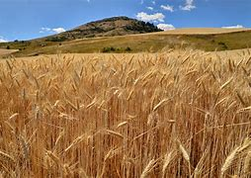
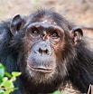
That Chemical Factory: Photosynthesis
What does INHABITED mean?
Flourishing Life Everywhere On Our Planet
Plants provide every thing needed to sustain animal and human life.
Plants are the ONLY organisms that can produce their own food!
(What did you have for breakfast this morning?)
Key?

Slide 12

Plants provide so many fundamental things needed for flourishing animal and human life:
Chemical Energy (Glucose, Starches and Carbohydrates)
Oxygen
Maintain Safe Carbon Dioxide Levels
Amino Acids, Proteins, Enzymes, Hormones
Essential Vitamins and Minerals
Lipids , Oils and Fats
Roughage for Digestion
Medicines
Habitat and Building Materials
Erosion Control
Weather Stability
Animal Life for Food (Food Chain)
Nutrients for Soil Health

Slide 13
And God said, “Behold I have given you every plant …; you shall have them for food. And to every beast …, and to every bird of the air and to everything that creeps on the earth, everything that has the breath of life, I have given every green plant for food.”
Gen 1:29-30

Slide 14
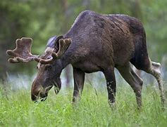
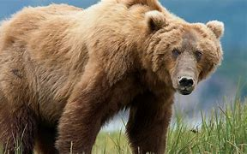
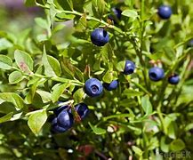
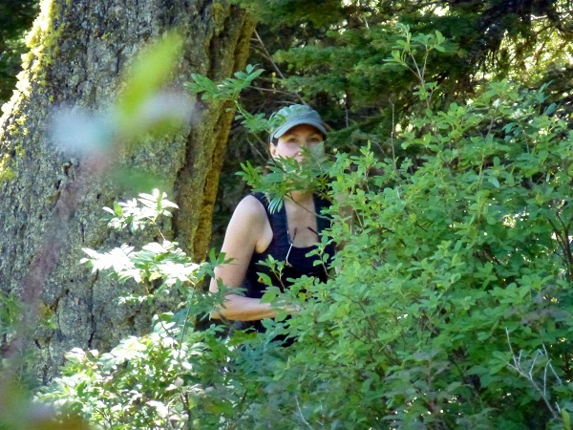

Slide 15

Let’s Think About This!
How did all this come about?

Slide 16
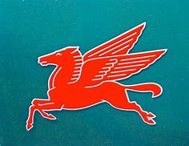
Do Horses Fly?

Slide 17
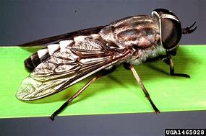
Some Horses Do Fly!!!

Slide 18
“Horses Fly”
IS THIS STATEMENT TRUE?
Absolutely
Likely
Possibly
Probably
Improbably
Impossible
Apply
Critical Thinking
Logic
To
Science
Reality
Bias
Need-Want
Hope
Agenda

Slide 19
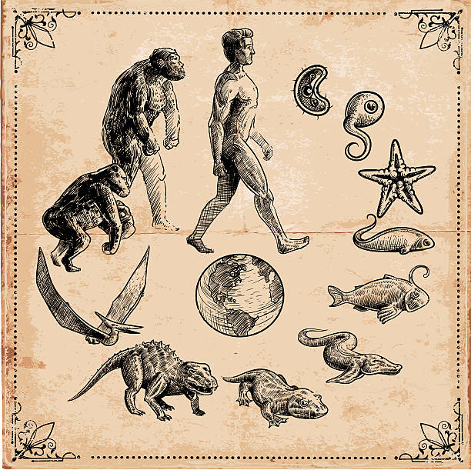
Photosynthesis
HOW DOES IT FIT INTO THE EVOLUTIONARY PICTURE?

Slide 20


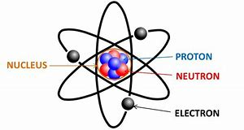
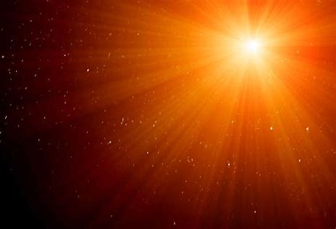

EVOLUTION: Nothing to Something
Time
Atoms
Energy

Slide 21
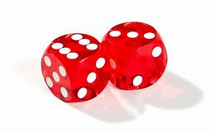
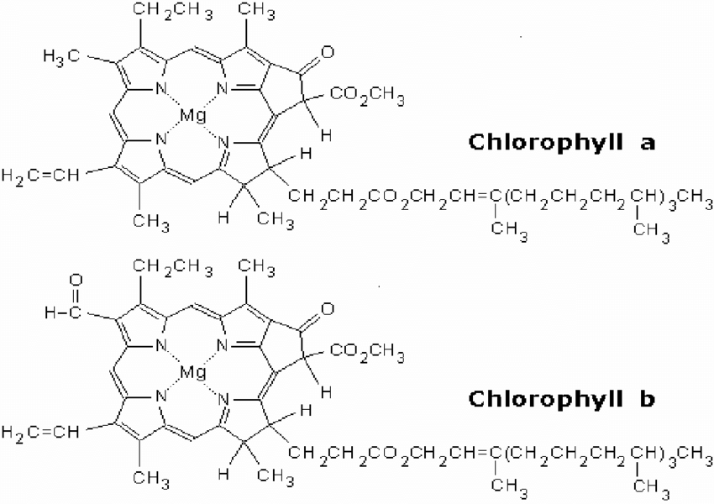
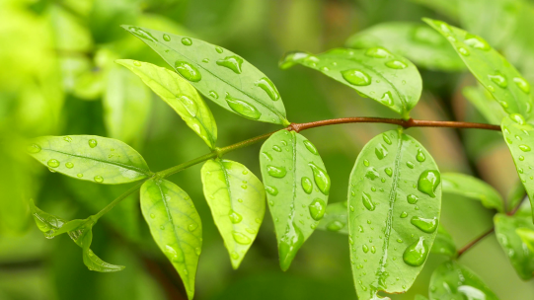

EVOLUTION: Something to Plants
Time
Atoms
Energy
Chance Chemical Interaction
Energy Conversion System
(Photosynthesis)
Plants and Other Photosynthetic Organisms
INTEGRATED COMPATIBITY

Slide 22
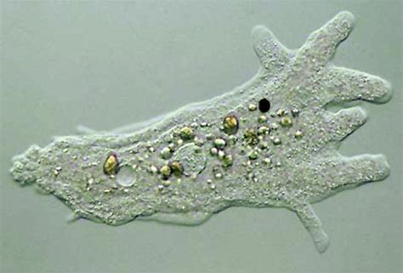
EVOLUTION: Something to 1st Animal Life
Time
Energy
Atoms
1st ANIMAL LIFE

Slide 23
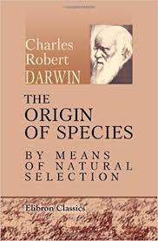
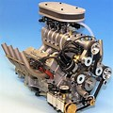
EVOLUTION: Microbes to Man
INTEGRATED COMPATIBITY
Time
Energy
1st ANIMAL LIFE
Plants and Other Photosynthetic Organisms
New Species
Or Kinds
Chance Mutational Gene Changes
Sexual Reproductive Engine to Pass on Gene Changes
Natural Selection Process to Preserve Positive Gene Changes Generation to Generation

Slide 24
PHOTOSYNTHESIS
WHY SO CRUTIAL FOR EVOLUTION?
(Or Life For That Matter?)
No Photosynthesis – No Plants
No Plants – No Oxygen or Food or Habitat
No Oxygen or Food or Habitat – No Animals or Humans

Slide 25
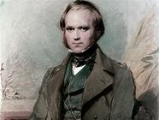
“If it could be demonstrated that any complex organ (or process like photosynthesis) existed, which could not have possibly been formed by numerous, successive, slight modifications, my theory would absolutely break down.”
Charles Darwin
Can it be demonstrated that photosynthesis “could have possibly been formed by numerous, successive, slight modifications and be compatible with plant and animal metabolism “?

Slide 26
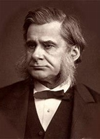
“The great tragedy of Science: the slaying of a beautiful hypothesis by an ugly fact”
Thomas Huxley
(Darwin’s Bulldog)

Slide 27
“Photosynthesis and Plants By Chance”
IS THIS STATEMENT TRUE?
Absolutely
Likely
Possibly
Probably
Improbably
Impossible
Apply
Critical Thinking
Logic
To
Science
Reality
Bias
Need-Want
Hope
Agenda

Slide 28
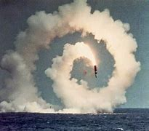
“Houston, we have a problem!”

Slide 29
EVOLUTION Says:
If you have enough TIME, even the most “irreducibly complex” organism or process (like Photosynthesis) could possibly have “formed by numerous, successive, slight modifications”.
Photosynthesis Says:
“You really don’t know how Chemistry operates in the real world”
“Long Ages” No Longer A FACTOR --- WHY?

Slide 30

Theme of the Presentation
#1
The Take-Away
As Huxley said:
“… the slaying of a beautiful hypothesis (evolution) by an ugly fact”
The ugly fact is:
Chemicals are kinda DUMB!
Chemicals react specifically and predictably but with no intended purpose or direction.
Chemicals do not organize themselves spontaneously or randomly to form complicated integrated chemical factories like Photosynthesis.

Slide 31
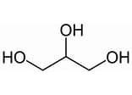
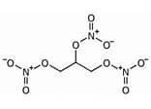
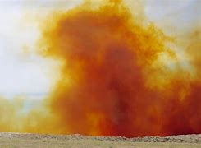

Sulfuric Acid +Nitric Acid
1969 High School
Chemistry
Glycerin
Nitroglycerin

Slide 32
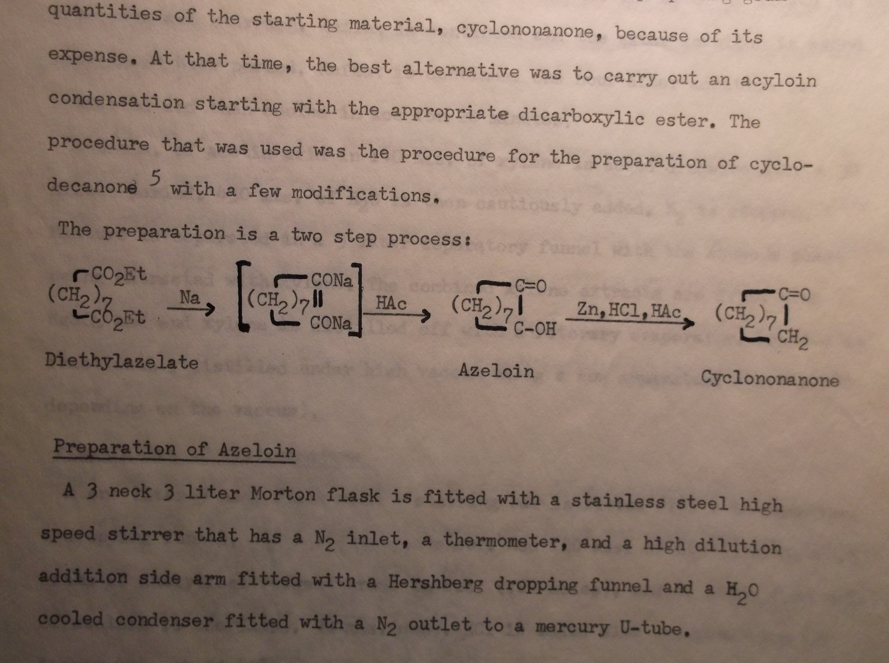
1971 College Chemistry
It Worked!

Slide 33
Theme of the Presentation
#2
The Take-Away
As Huxley said:
“… the slaying of a beautiful hypothesis (evolution) by an ugly fact”
The “ugly” fact is:
Photosynthesis is a designed, complicated, integrated chemical FACTORY to supply energy
to living systems: Plants, Animals, Humans

Slide 34
What Does it Mean that Photosynthesis is an
Designed,
Complicated,
Integrated,
Chemical
Factory?
And how does that fly in the face of evolutionary dogma?

Slide 35
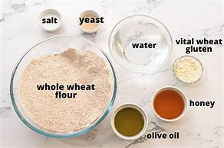
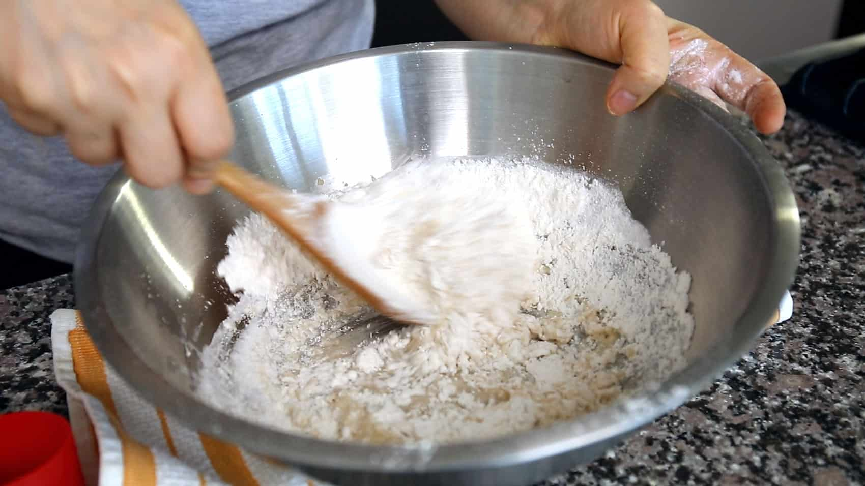

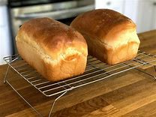
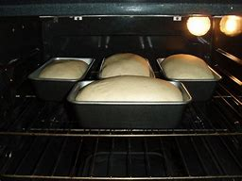
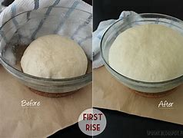
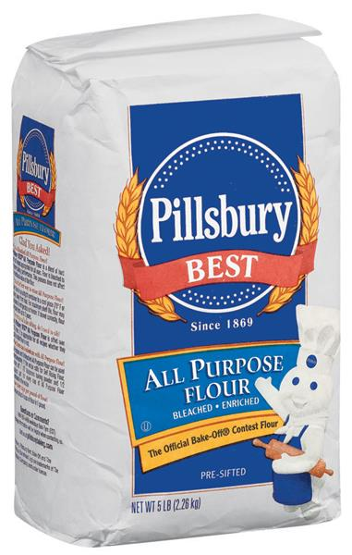
Bread Making (Factory)
Simple Process?
Yes But -
Where did the flour come from?

Slide 36
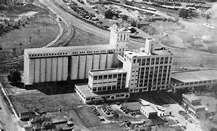
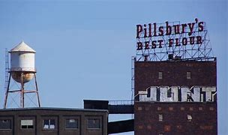
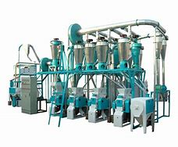
Flour Mill

Slide 37
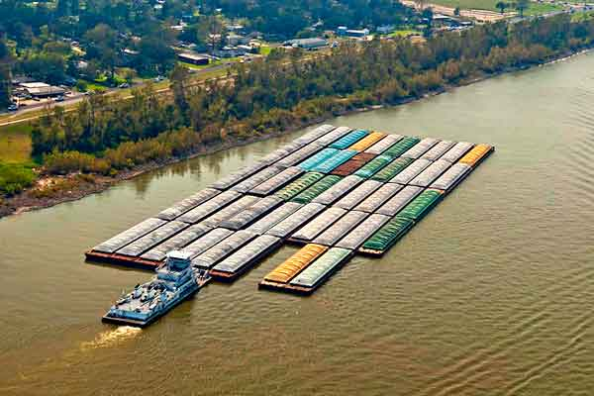
Wheat Transport to the Mills

Slide 38
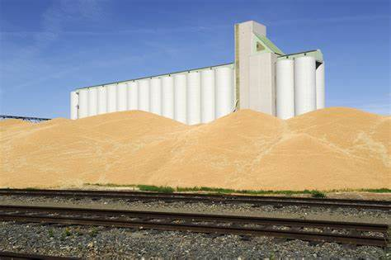
Wheat Storage During Harvest

Slide 39
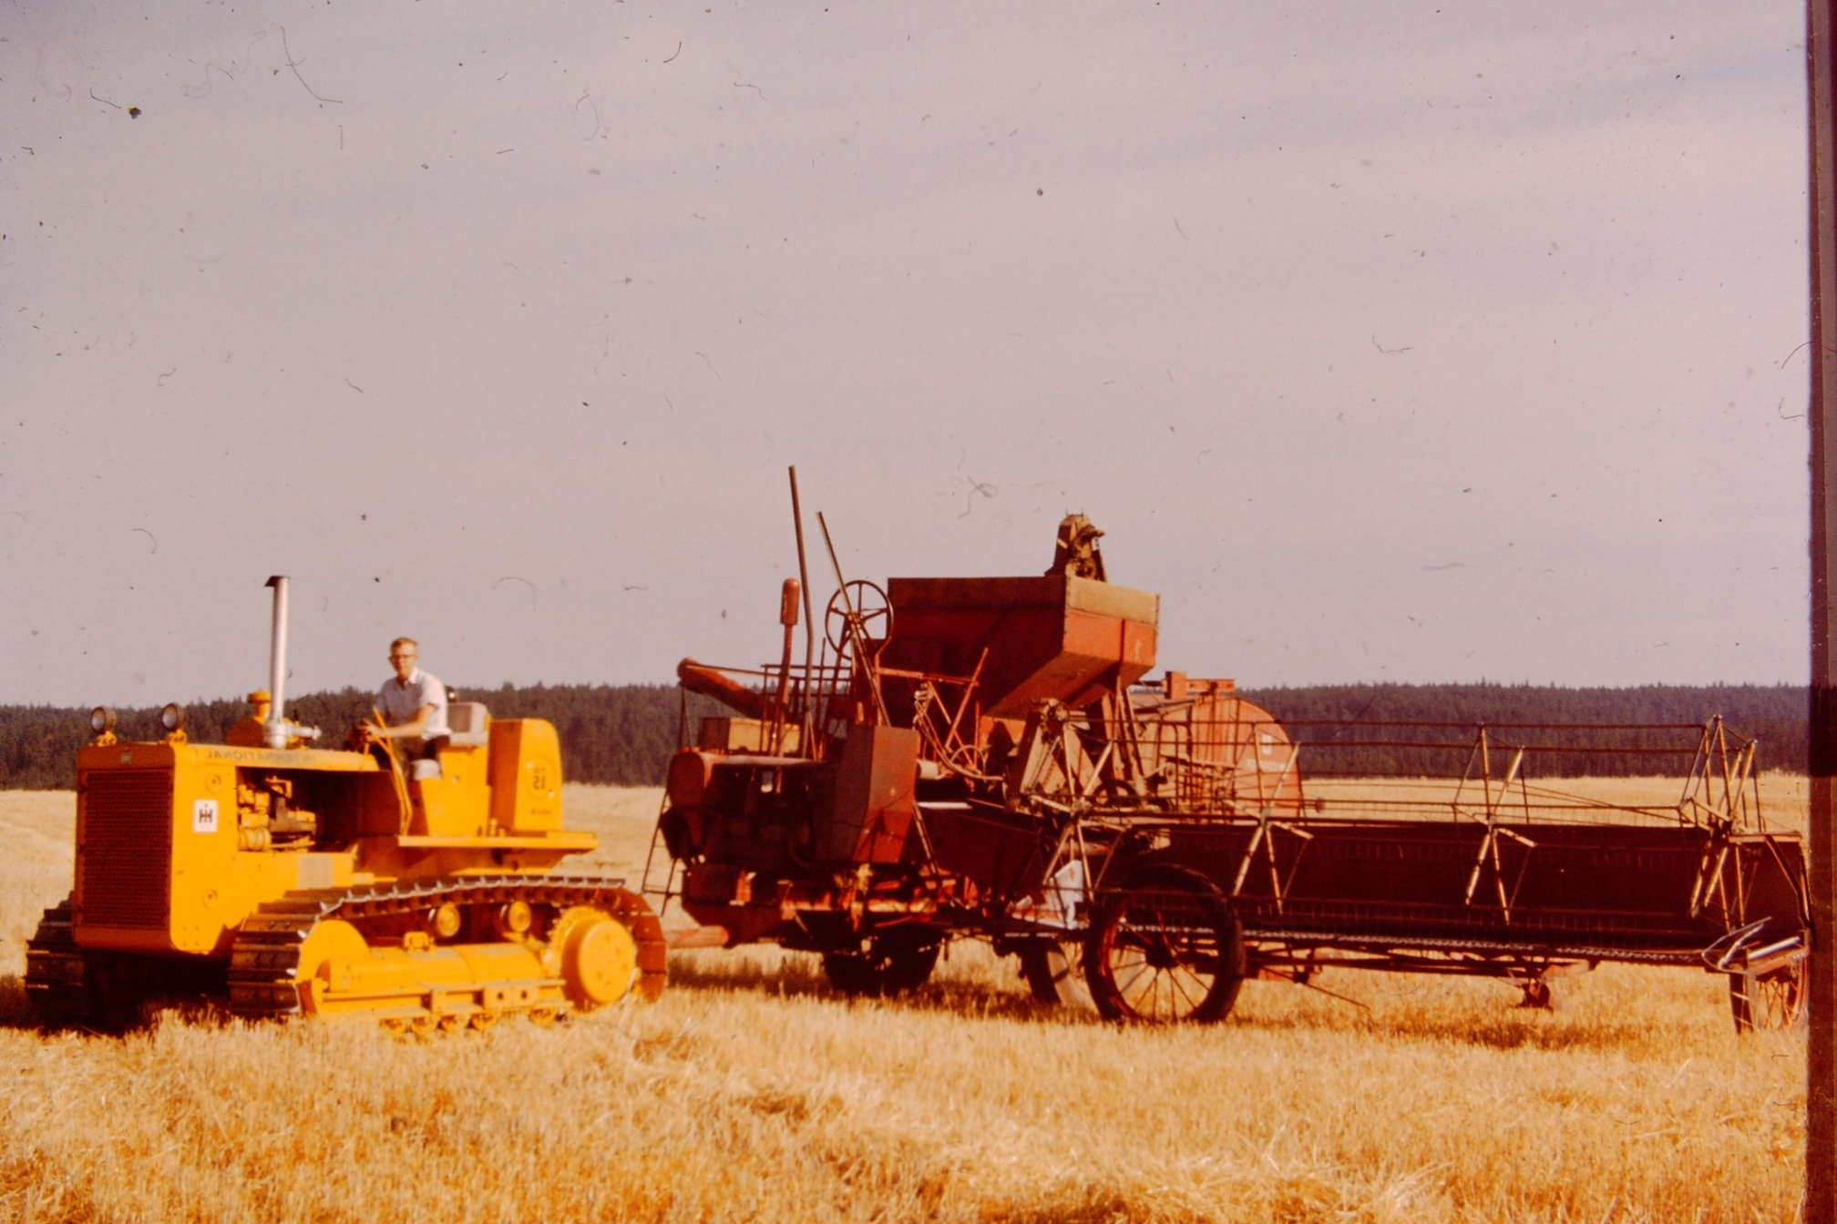
My combine in Dayton Wa 1965

Slide 40
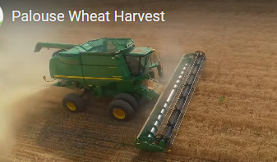
My Niece’s
8000 Acre Farm
In Dayton Wa 2022
Where are the Goodyear tires made?
What happens to the whole process of making bread if Goodyear stops making tires?

Slide 41
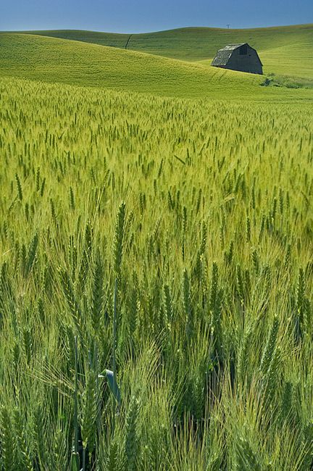
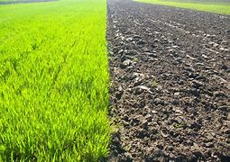
Photosynthesis Factory
At Work

Slide 42
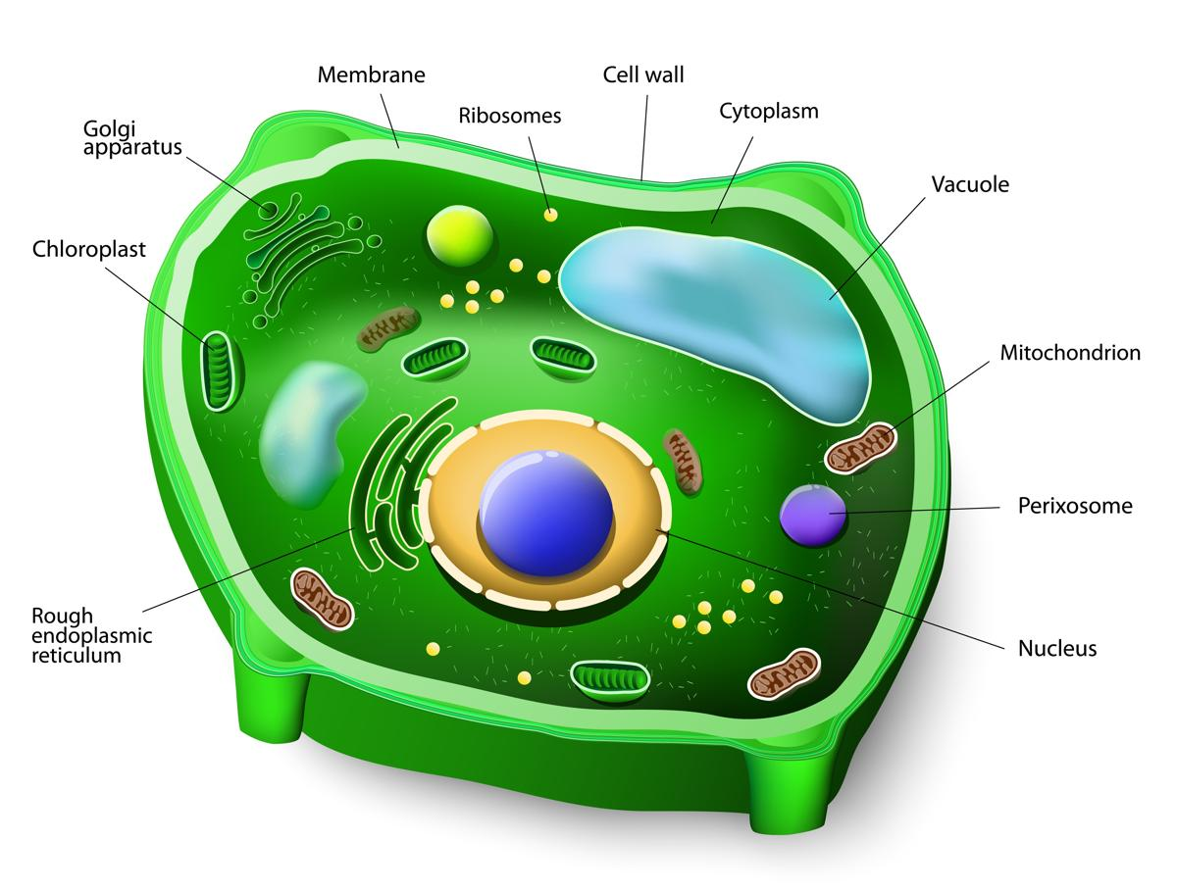
Plant Cell Structure

Slide 43
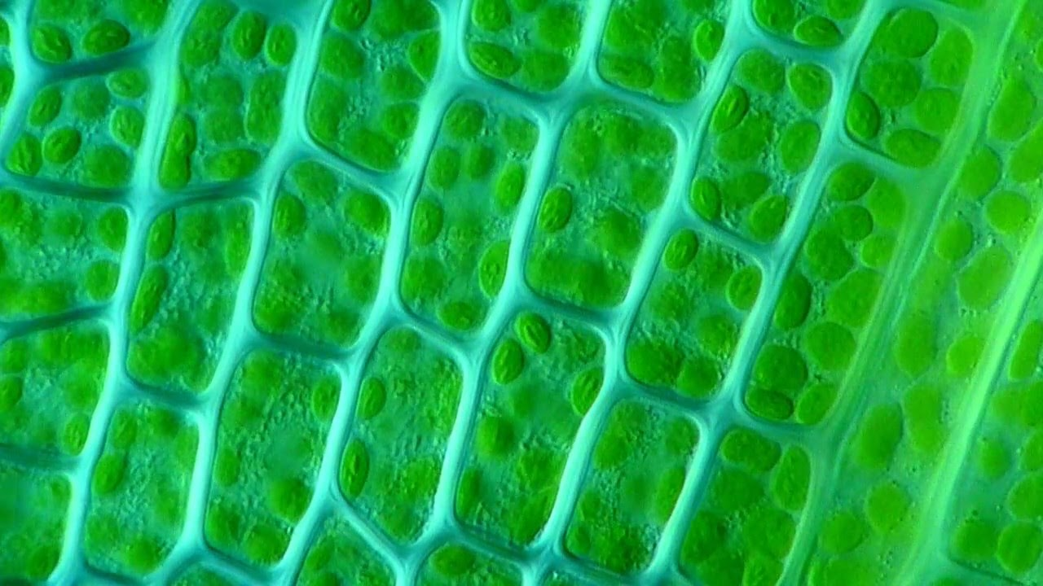
Moss Leaf Chloroplasts

Slide 44

Chlorophyll

Slide 46




Slide 47
Chlorophyll

Slide 48

Step 1

Slide 49


Slide 50


Slide 51
Step 1
7
3
5
6
4
CALVIN
CYCLE
a
2
8

Slide 52


NADPH
ATP
Nicotinamide adenine dinucleotide phosphate.
Adenosine triphosphate

Slide 53
Chlorophyll

Slide 54

STEP 1
START
CALVIN CYCLE
STEP 2
STEP 4
STEP 3

Slide 55

RubisCo Enzyme

Slide 56

Integrated Chemical Factories

Slide 57
Energy
Chemicals
Cell Making New Chloroplasts
Chloroplasts Supplies Energy and Chemical Building Blocks for Cell Metabolism
Cell DNA and Components manufacture and support
Chloroplasts

Slide 58
Would you agree that Photosynthesis is an
Designed,
Complicated,
Integrated,
Chemical
FACTORY?
And how does Photosynthesis Process (Factory) fly in the face of evolutionary dogma?
Remember we said Chemicals are kinda DUMB?

Slide 59
Like the Goodyear tires on a combine:
If one tiny amino acid is missing or out of place the entire photosynthesis process cannot function.
All complete functioning types and sequences of chemical factories have to be in place from the start.
Functioning Photosynthesis supplies energy to the plant’s metabolism but the plant’s metabolism forms and sustains the Photosynthesis: Which came first?
The Plant’s DNA defines the photosynthesis factory structure yet energy from photosynthesis is required for DNA to be manufactured and maintained and function: Which came first?
Factory Products Products Factory

Slide 60
-It’s All or Nothing-
If any of these problems happens: no energy, no plants, no life?
It seems the evolutionary process for Photosynthesis is DOA!
Either the Evolutionary Theory needs to be revised or perhaps scrapped!

Slide 61

Origin of Photosynthesis and Plants:
Evolutionary Answers

Slide 62

Garfield’s Model of
“Evolutionary Origins”
Fortunately for the evolutionary theory:
Simple chemicals formed complex, integrated bio-chemicals contrary to Chemical Science
Plants evolved first, then in “another 15 minutes” animals evolved with commentary metabolisms

Slide 63

Sea Slug
Plant or Animal?

Slide 64
Theme of the Presentation
The Take-Away
As Huxley said:
“… the slaying of a beautiful hypothesis (evolution) by an ugly fact”
The “ugly” facts are:
Chemicals are kinda dumb – they don’t form complicated chemical factories by themselves.
Photosynthesis is a designed, complicated, integrated chemical factory supplying energy
to living systems: Plants, Animals, Humans

Slide 65

Logical Deduction
Your Christian Faith
It is rational and reasonable to believe that God, not unknown events, created Photosynthesis fully functional to facilitate a flourishing world, not in chaos, but to be inhabited.

Slide 66
For thus says the Lord, who created the heavens (He is God), who formed the earth and made it (He established it;
He did not create it in chaos,
He formed it to be inhabited):
I am the Lord, and there is no other.
Isa 45:18

Slide 67

He formed it to be inhabited so we could have a relationship with Him
That’s why Jesus came re-establish our relationship with God

Slide 68

God gave us plants to thrive physically
God gave us the “Bread of Life” to thrive spiritually

Slide 69
Have you received Jesus, the “Bread of Life” for yourself?
And just as it is appointed for men to die once, and after that comes judgement, so Christ, having been offered once to bear the sins of many, will appear a second time, not to deal with sin but to save those who are eagerly waiting for Him
(Heb 9:27-28)

Slide 70
Jesus died for us on the cross to take on the penalty for our sin and rebellion against God
And was raised from the dead so we could have new life in fellowship with God
Are you “waiting” on and trusting Jesus?

Slide 71

Remember Our Task
Be prepared to make a solid defense to those who challenge our faith
1 Peter 3:15

Slide 72

Ask Critical Questions
How do you know it is true?
Has it ever been observed?
Are you making any assumptions?

Slide 73
Psalm 118:8
It is better to take refuge in the Lord than to put confidence in man.
Psalm 111:2
Great are the works of the Lord, studied by all those who have pleasure in them.

Slide 74

Dan 1:4
Daniel and his three friends were trained so they would be:
“…skillful in wisdom, and cunning in knowledge and understanding science…”

Slide 75


Consider a Summer Family Field Trip
Mt. St. Helens
Dry Falls

Slide 77
The Calvin cycle has four main steps. Energy to fuel chemical reactions in this sugar-generating process is provided by ATP and NADPH, chemical compounds that contain the energy plants have captured from sunlight.
In step one, a carbon molecule from carbon dioxide is attached to a 5-carbon molecule called ribulose biphosphate (RuBP). The method of attaching a carbon dioxide molecule to a RuBP molecule is called carbon fixation. The 6-carbon molecule formed by carbon fixation immediately splits into two, 3-carbon molecules called 3-phosphoglycerate (3-PGA).
In step three, some of the G3P molecules are used to create sugar. Glucose, the type of sugar produced by photosynthesis, is composed of two G3P molecules.
In step four, the G3P molecules that remain combine through a complex series of reactions into the 5-carbon molecule RuBP, which will continue in the cycle back to step one to capture more carbon from carbon dioxide.
Calvin Cycle Details

Slide 78
In an everyday scene so bizarre that science fiction writers might never have imagined it, algae-eating sea slugs actually hijack chloroplasts—those tiny plant structures that perform photosynthesis—and use them as energy producers for themselves.
Solar-powered sea slugs begin by eating algae, just like other slugs and snails. But that’s where the similarities stop. Once the algae is in their gut, these sea slugs use tiny specialized finger-like cellular extensions to detect, select, and literally grasp chloroplasts out of the chewed-up algae and bring them inside their body cells.
Some solar slug species then coat those engulfed chloroplasts with a special membrane before transporting them along networks of tubes that extend into leaf-like flaps found on the slug’s back. Incredibly, the slug’s body cells actually harbor and nurse these stolen chloroplasts for up to a year, taking advantage of the sugars produced by the solar-powered biochemical machinery. The slugs can also fold their flaps or move to murkier waters after they’ve metabolized enough of their sunlight-energized sugar to prolong the life of their enslaved chloroplasts.
Also, the slugs provide hundreds of proteins to maintain their photosynthetic machinery. Where did they get the unique genes that code for those chloroplast-sustaining proteins?

